Slide 1
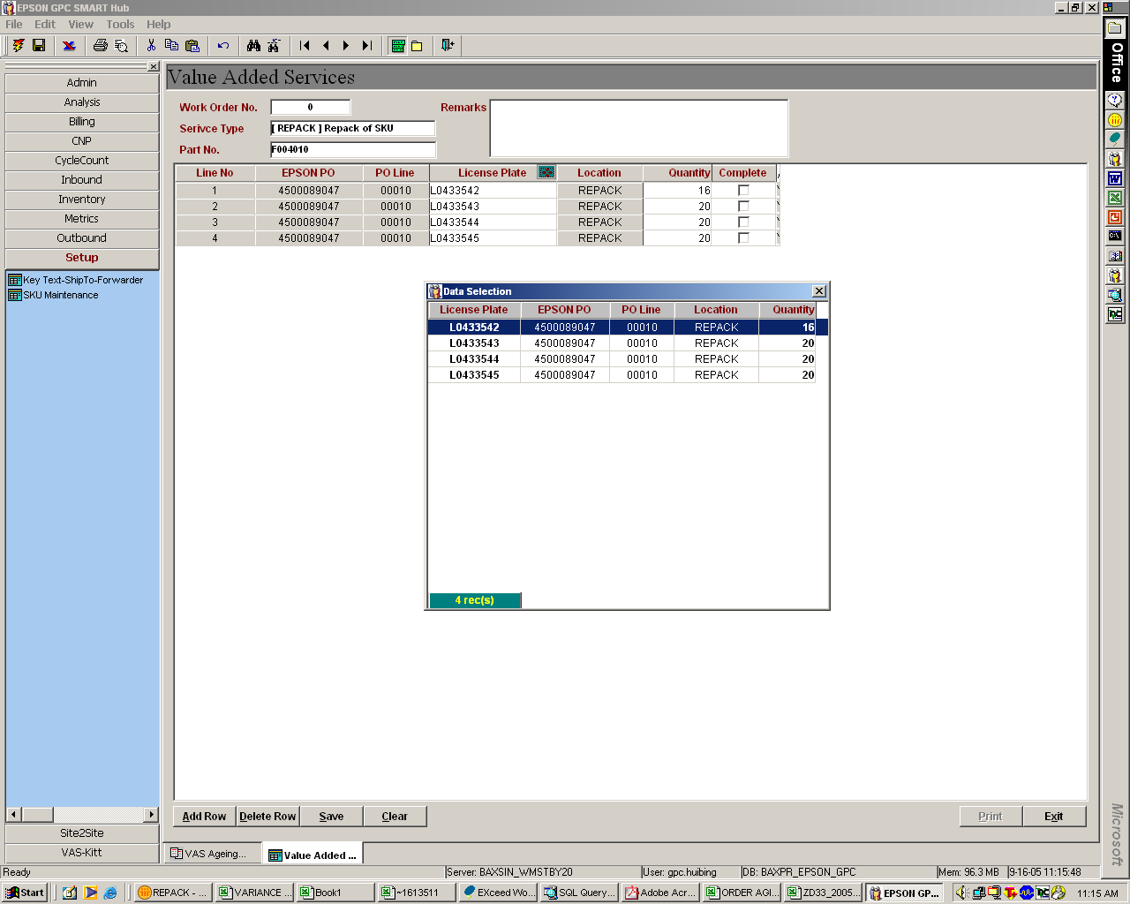
Step 2:
Functions remain as per status quo for ad-hoc partial amendment
Step 1:
- Key in Part No. and Tab
- Auto-add all inventory in ‘REPACK’ location for the Part No.
To minimize user manual data selection
Step 2:
Functions remain as per status quo for ad-hoc partial amendment

Slide 2
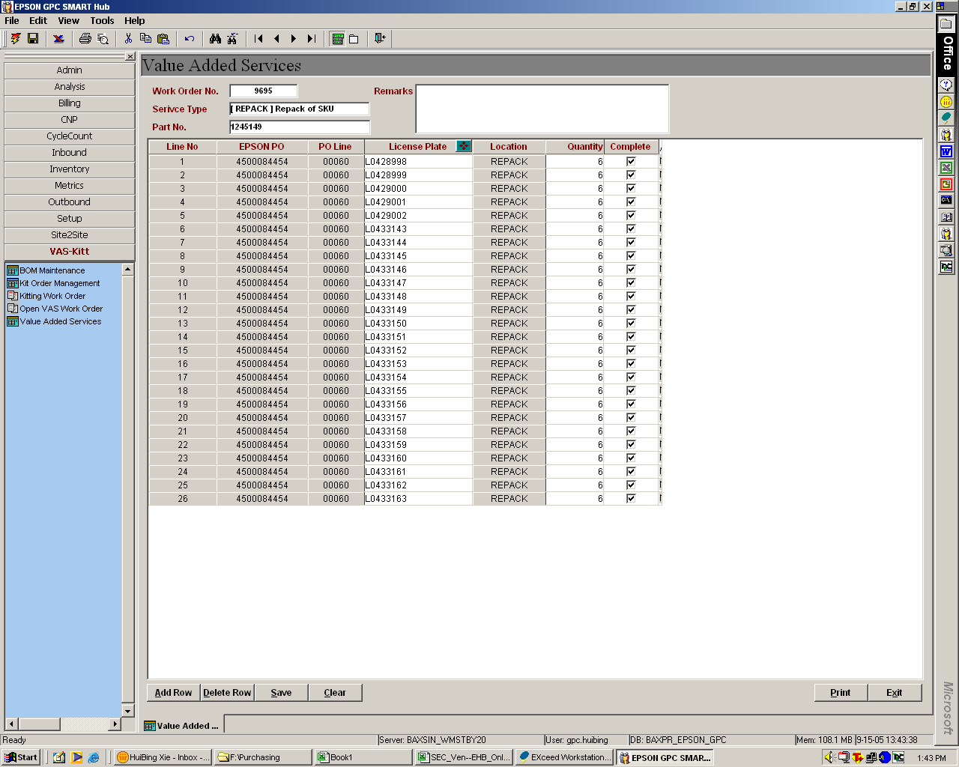
Allow user to uncheck any box
Include a “Check All” icon which checks all boxes upon clicking

